Slide 1
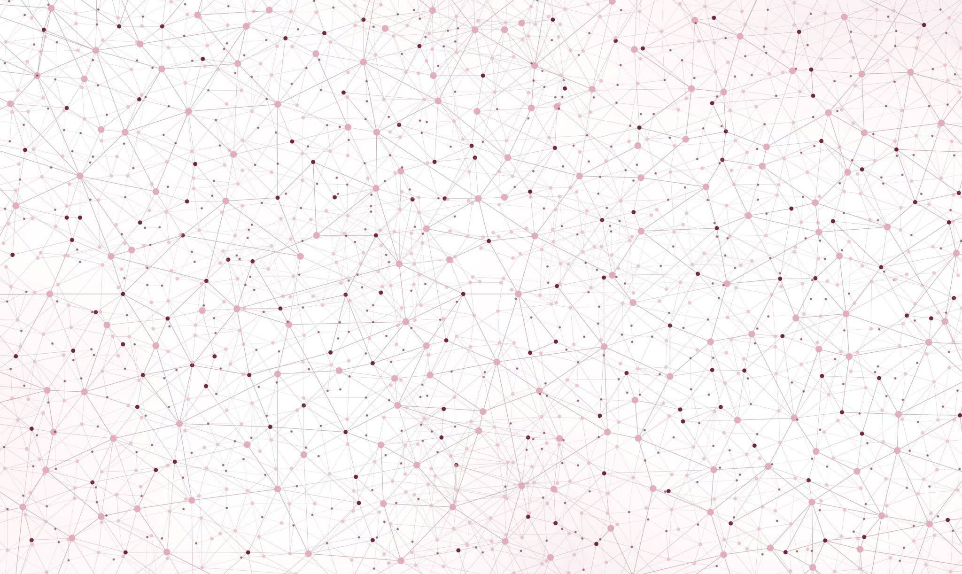
Cell Nuclei Segmentation
Implementation and Evaluation
of Otsu Thresholding
Final presentation
Topic 01: Biomedical Image Analysis
Supervisor: PD Dr. Karl Rohr, Christian Ritter, Tutor: Marie Becker
Group 01.04: Marie-Claire Indilewitsch, Helen Jade, Maribel Schneider, Ieva Sorokina-Ozola
Date: 20.07.2022

Slide 2


Timeline recap
First steps
Final presentation
Local Otsu thresholding
Otsu and Dice
10.05.
31.05.
14.06.
Buffer and report
28.06.
21.06.
17.05.
07.06.
Cell counting
Two-level Otsu thresholding
Project proposal
Preprocessing and testing

Slide 3

Median filter
3 datasets
Global Otsu thresholding
Two-level Otsu thresholding
Gaussian filter
Histogram stretching
Preprocessing
Postprocessing
Local adaptive Otsu thresholding average
Hole filling
Two-level Otsu thresholding clip
Dice Score
Optimal segmented image

Slide 4
Overview
Challenges
Summary- the perfect recipe
Results and Discussion
Recap datasets difficulties

Slide 5
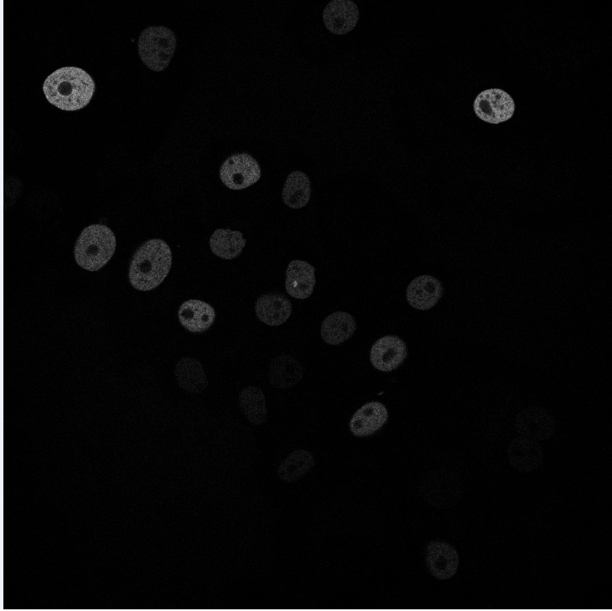
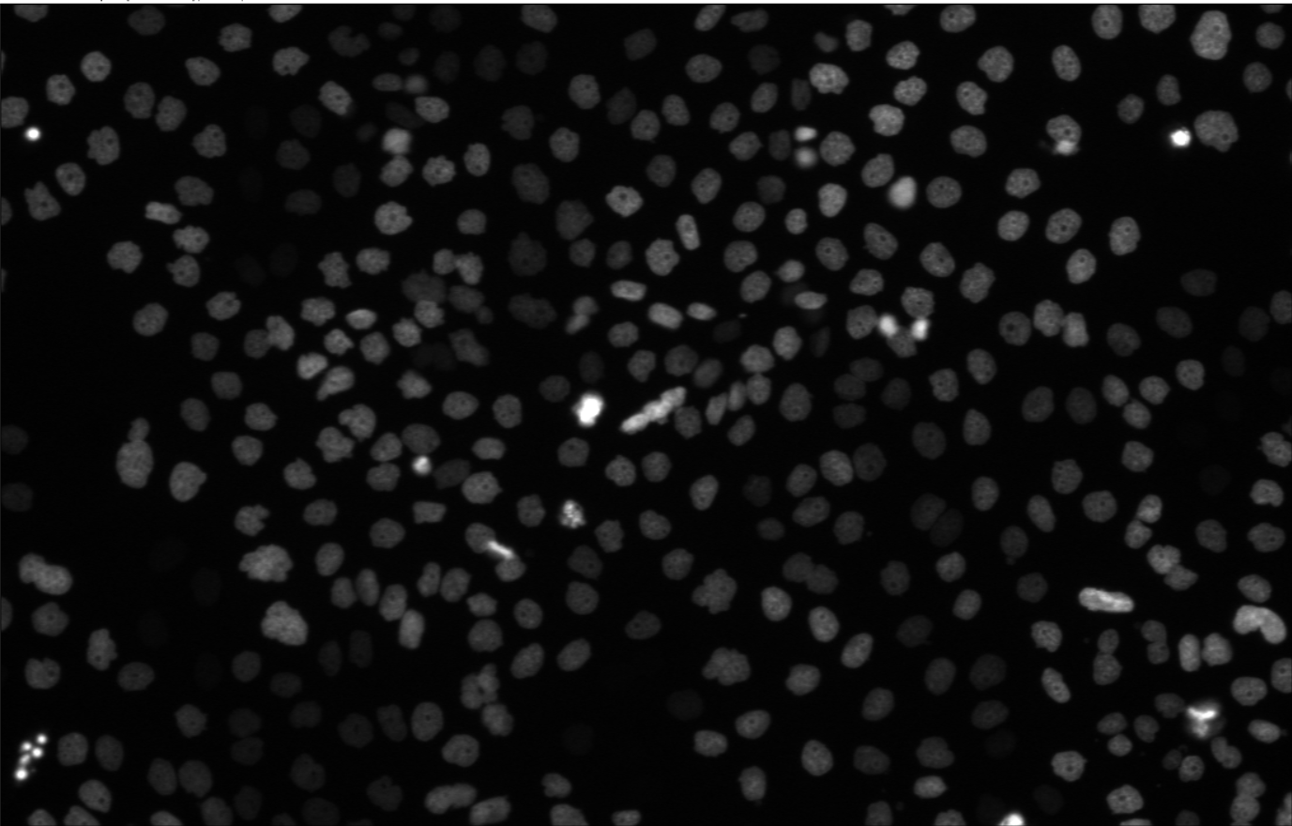
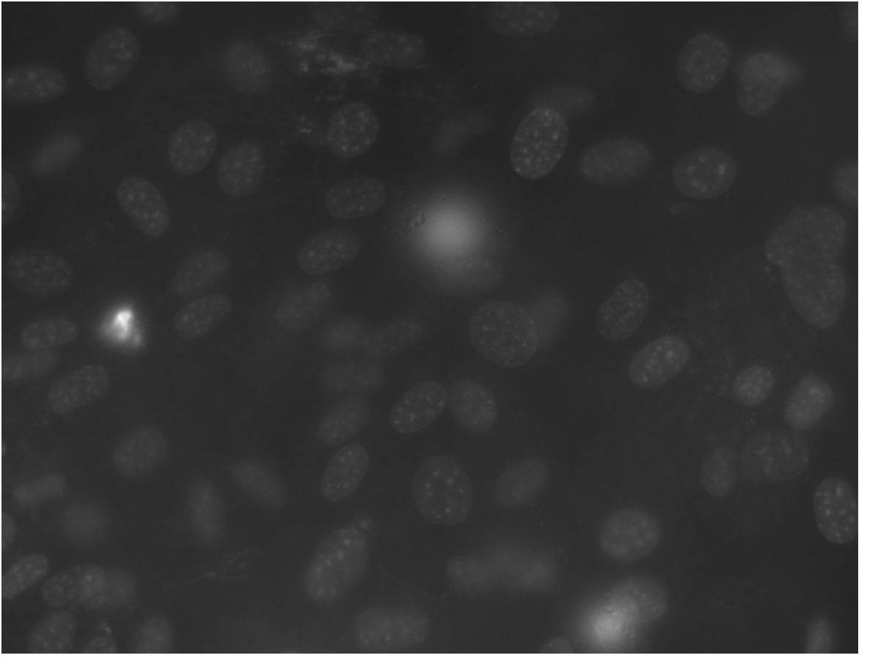


N2DL-HeLa (second dataset)
N2DH-GOWT1 (first dataset)
NIH3T3
(third dataset)
Noise
Low contrast
Holes
Varying brightness of cell nuclei
Low contrast
Non-uniform illumination
Reflections
L: low resolution
N: nuclear
H: high resolution
2D: two-dimensional

Slide 6
Expectations
 | Challenge | Preprocessing method | Otsu thresholding variation
N2DH-GOWT1 | Noise Low contrast Holes | Filters Histogram stretching and combinations +postprocessing | Global Otsu Two-level Otsu
N2DL-HeLa | Varying brigtness of cell nuclei Low contrast | Filters Histogram stretching and combinations | Global Otsu Two-level Otsu Local adaptive thresholding
NIH3T3 | Non-uniform illumination Reflection | Filters Histogram stretching and combinations | Global Otsu Two-level Otsu (+clip) Local adaptive thresholding
Which combination between preprocessing method and Otsu thresholding variation leads to the best segmentation outcome?

Slide 7
Global Otsu thresholding

Slide 8
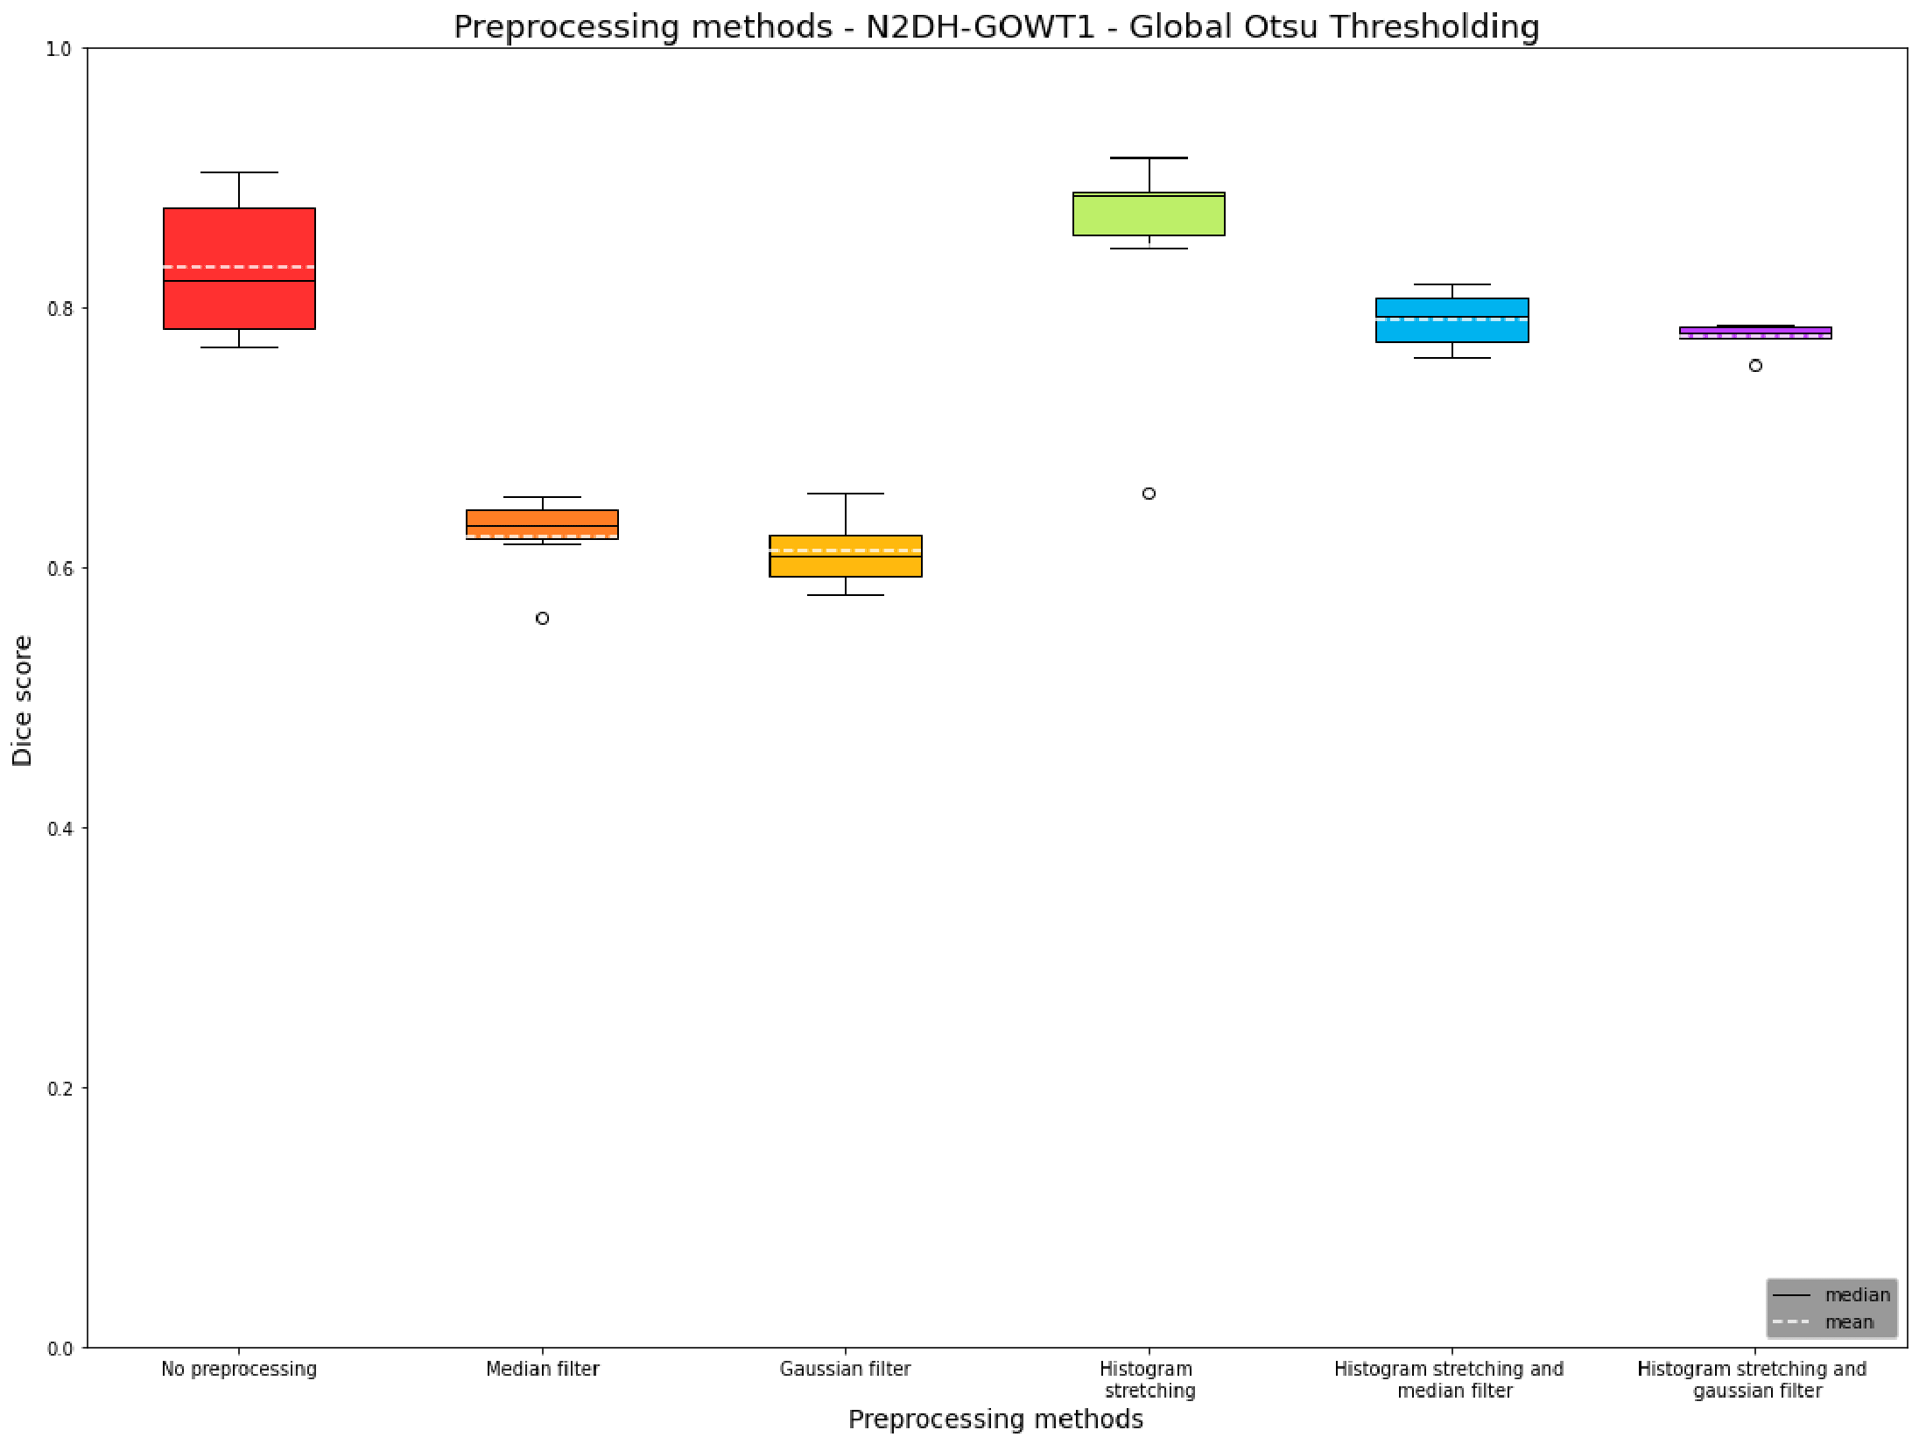
Preprocessing methods - N2DH-GOWT1 and N2DL-HeLa
No Preprocessing
Median filter
Gaussian filter
Histogram stretching
Histogram stretching and median filter
Histogram stretching and Gaussian filter

Slide 9
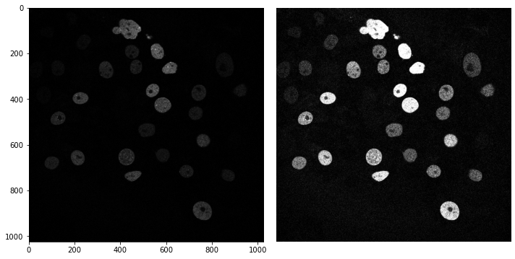
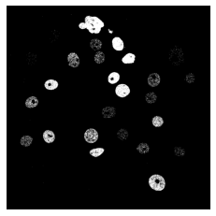
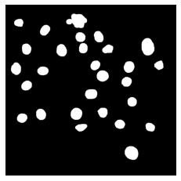
N2DH-GOWT1: Effects of histogram stretching
Original image
Segmentation (no preprocessing)
Ground truth

Slide 10
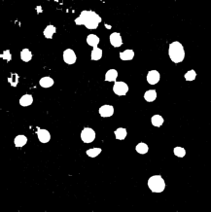
N2DH-GOWT1: Effects of histogram stretching
Histogram stretching
Segmentation with hole filling
Ground truth

Slide 11
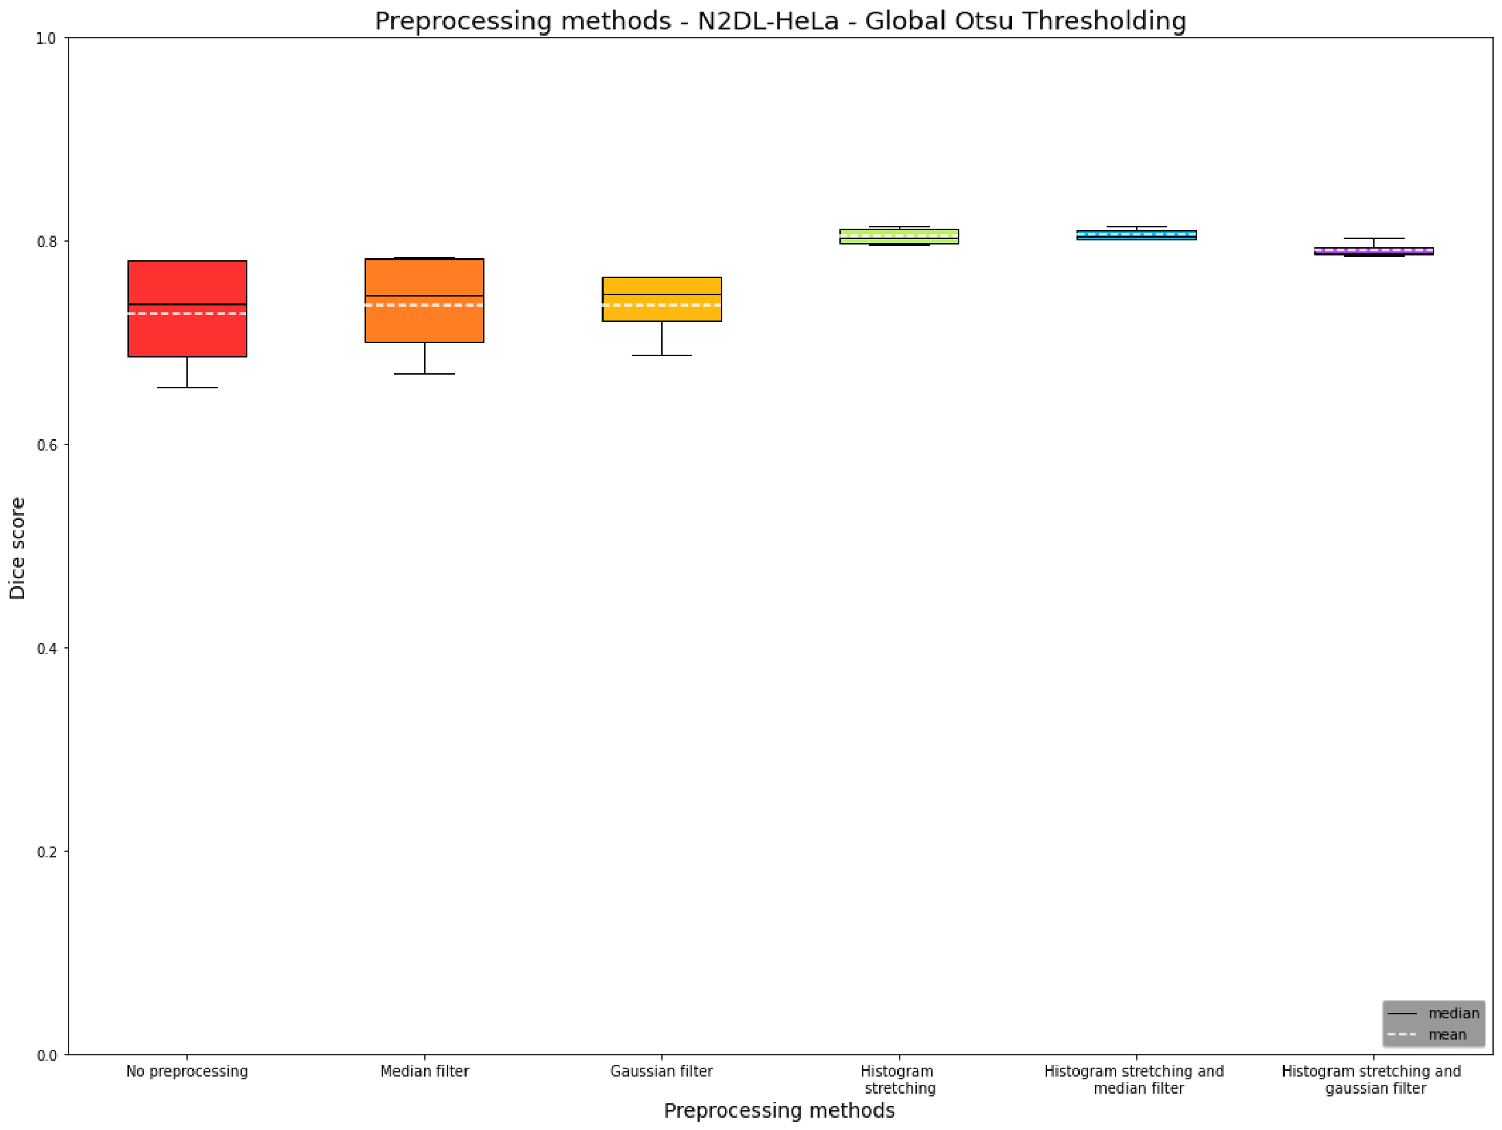
Preprocessing methods - N2DH-GOWT1 and N2DL-HeLa
No Preprocessing
Median filter
Gaussian filter
Histogram stretching
Histogram stretching and median filter
Histogram stretching and Gaussian filter

Slide 12
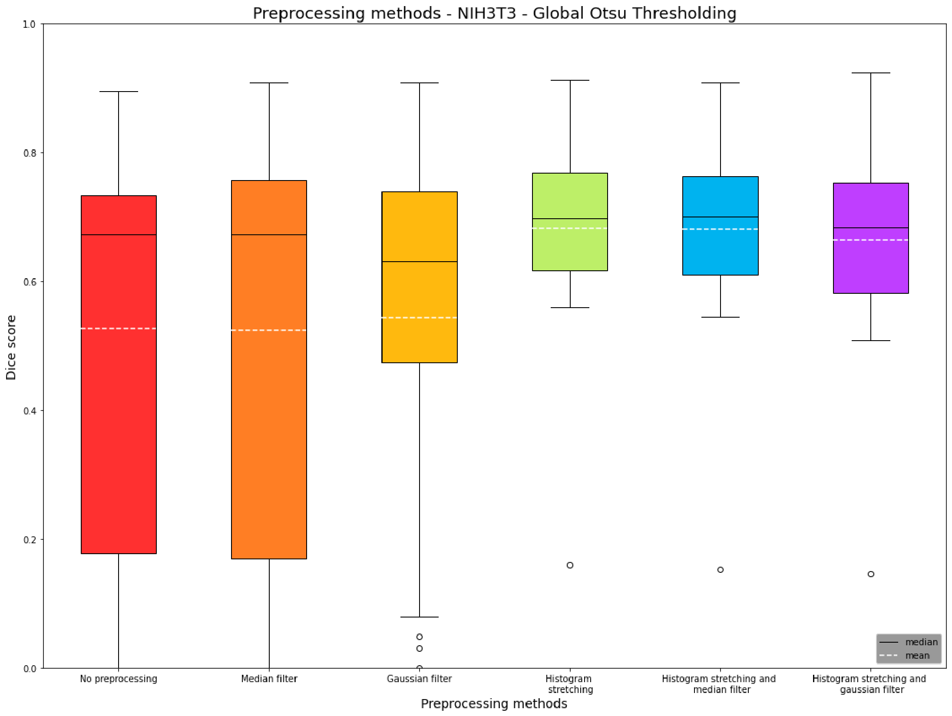
Preprocessing methods - NIH3T3
No Preprocessing
Median filter
Gaussian filter
Histogram stretching
Histogram stretching and median filter
Histogram stretching and Gaussian filter

Slide 13
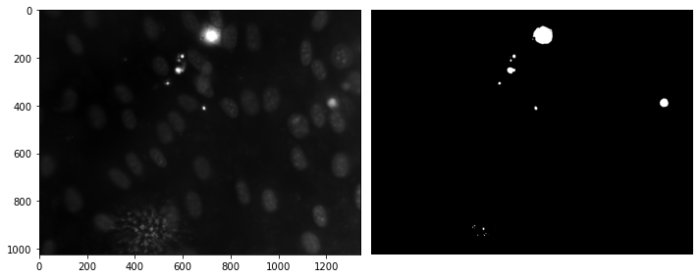
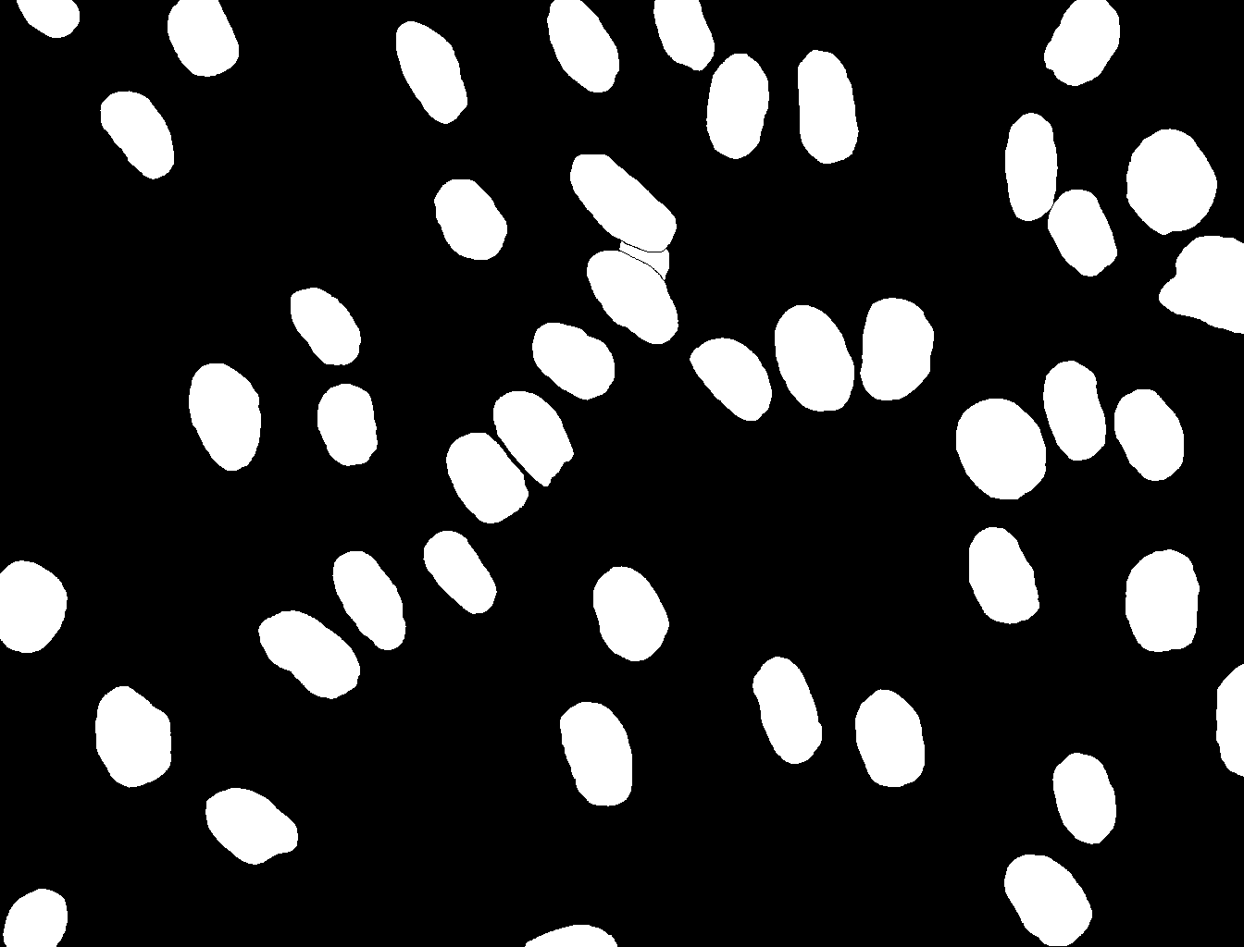
NIH3T3: Effect of reflections
Original image
Segmentation (no preprocessing)
Ground truth

Slide 14
Two-level Otsu thresholding

Slide 15
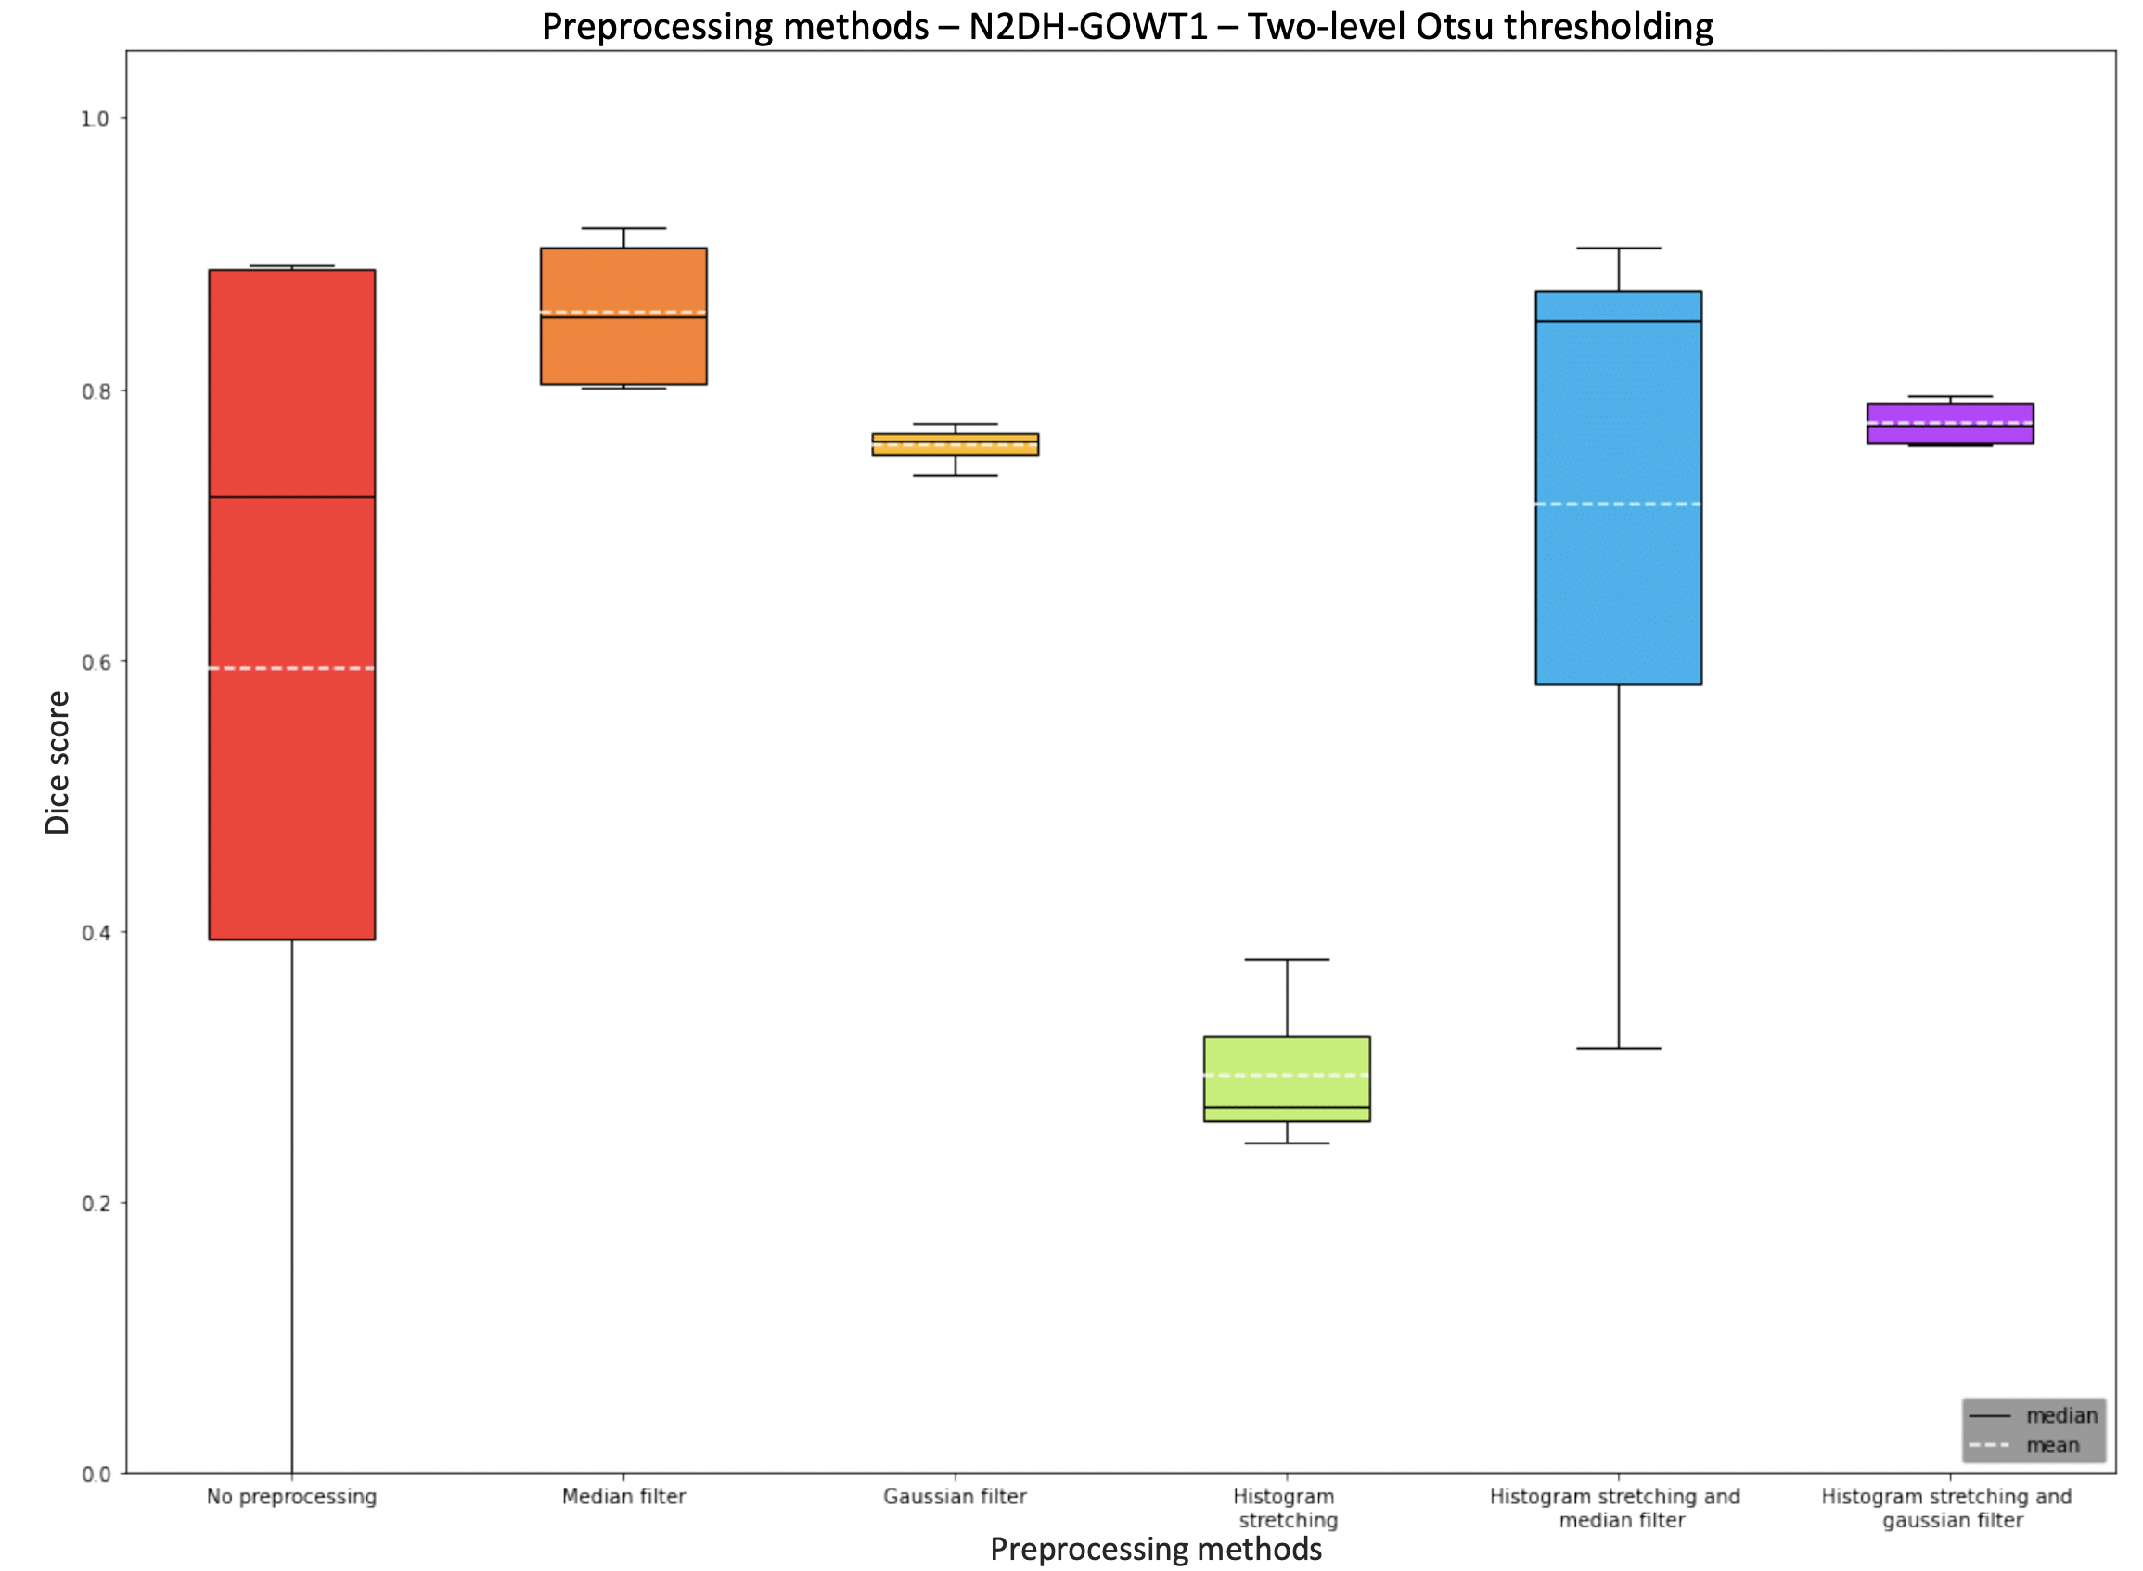
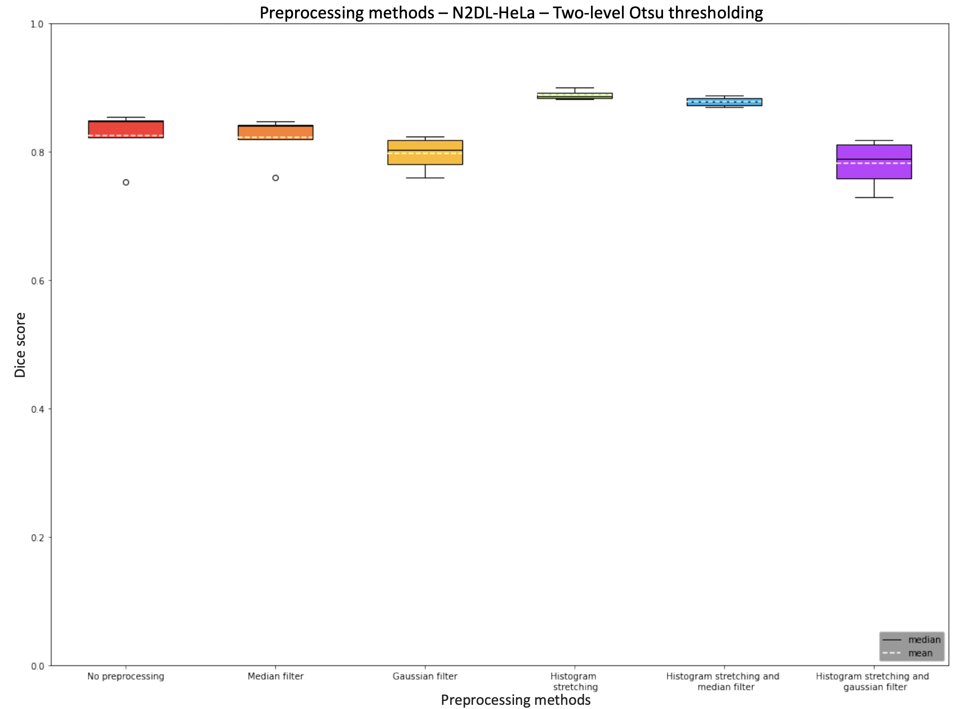
Preprocessing methods - N2DH-GOWT1 and N2DL-HeLa
No Preprocessing
Median filter
Gaussian filter
Histogram stretching
Histogram stretching and median filter
Histogram stretching and Gaussian filter

Slide 16
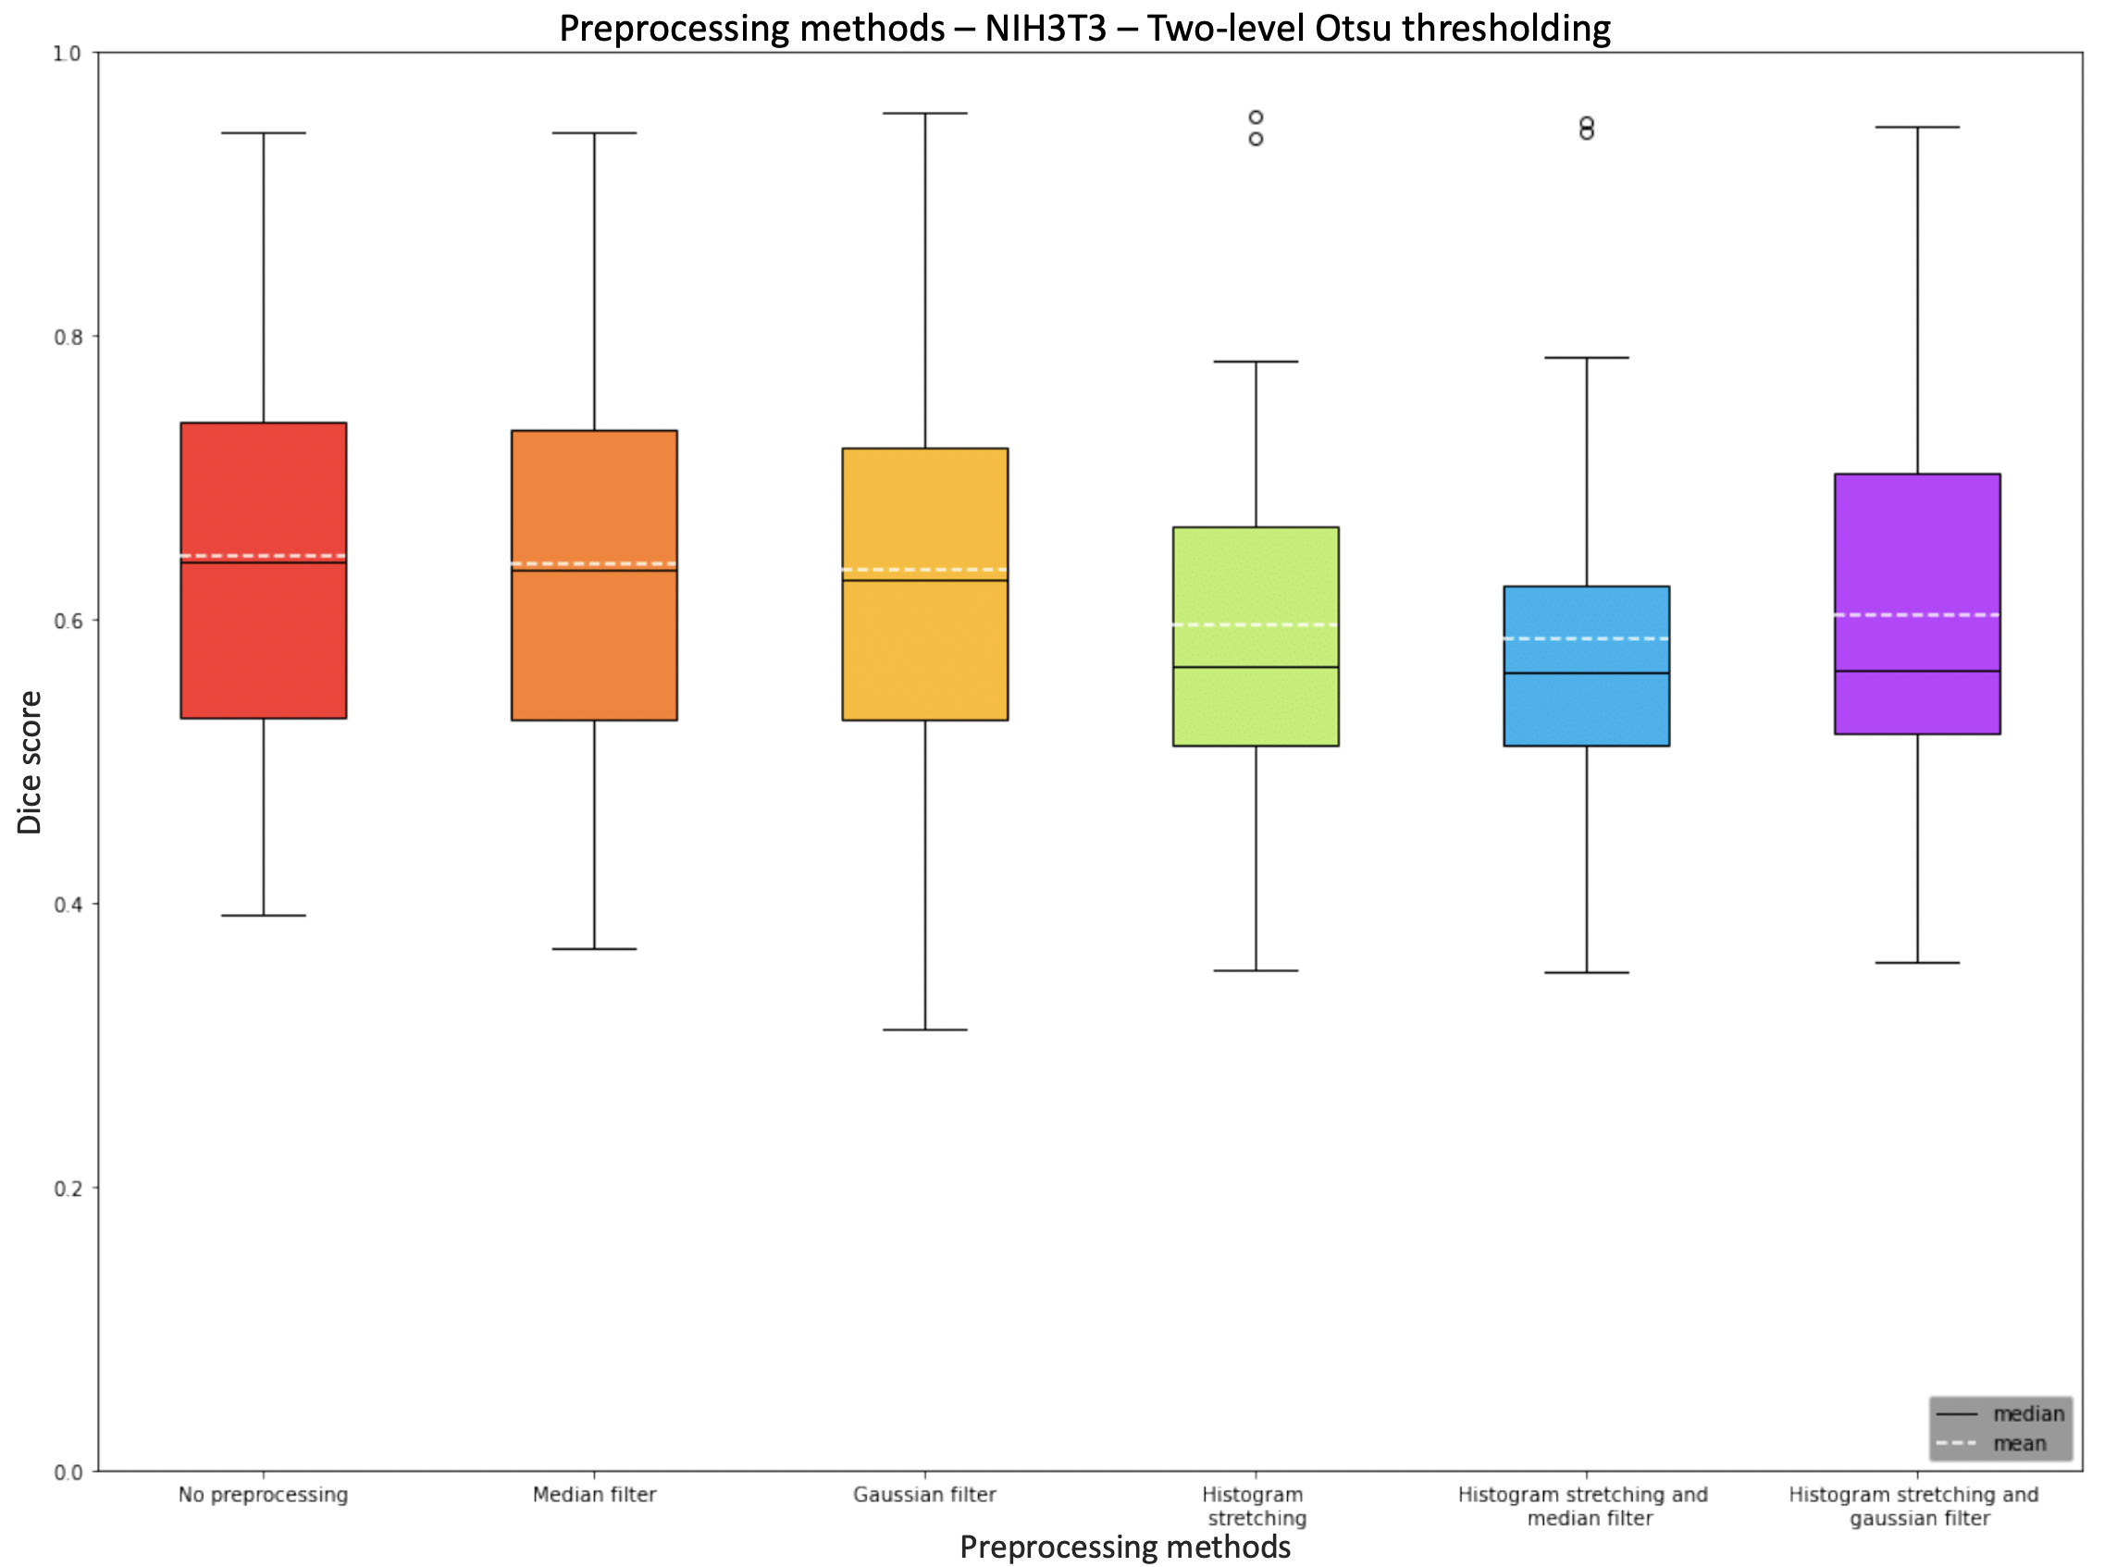
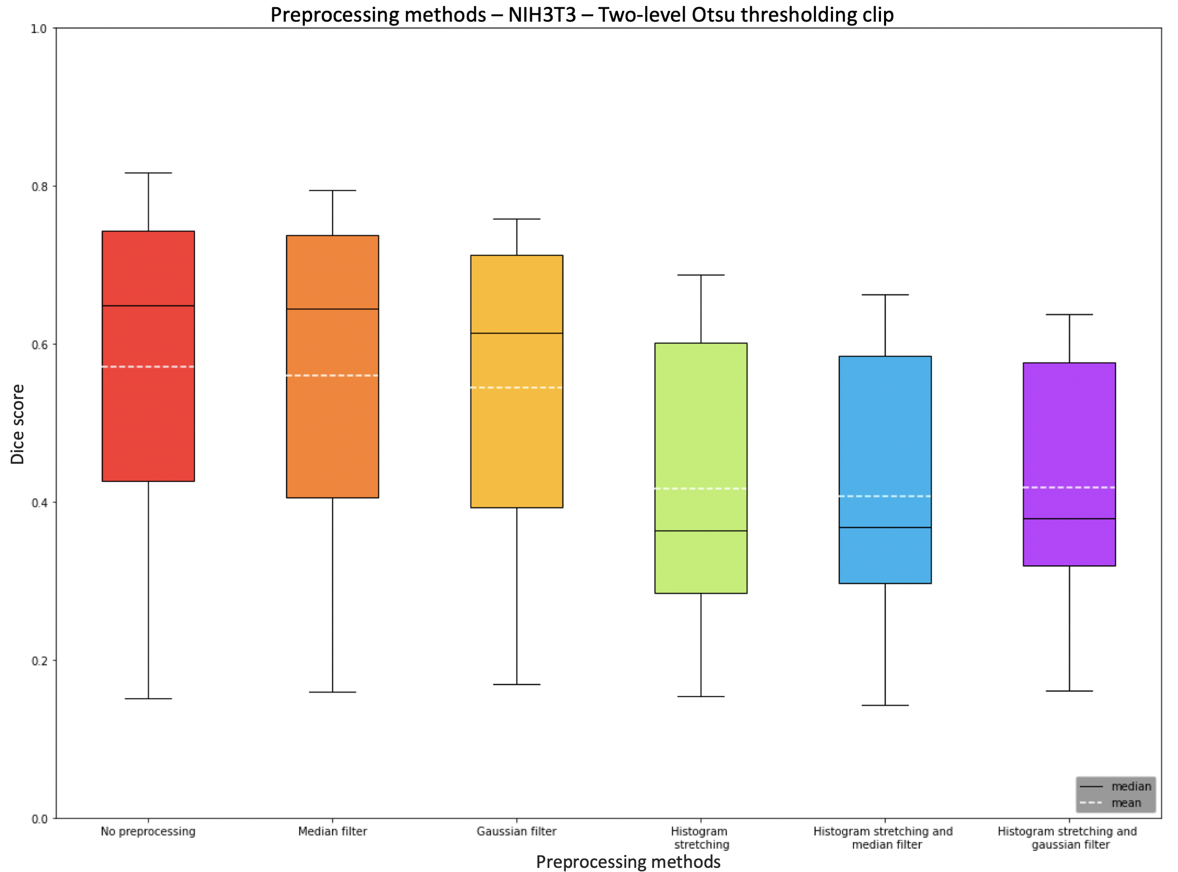
Preprocessing methods NIH3T3 two-level Otsu and clip
No Preprocessing
Median filter
Gaussian filter
Histogram stretching
Histogram stretching and median filter
Histogram stretching and Gaussian filter

Slide 17
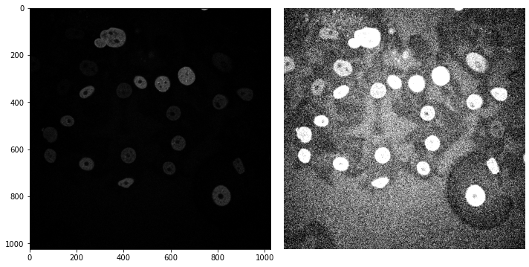
N2DH-GOWT1: Effects of histogram stretching
Original image
Segmentation (with histogram stretching)

Slide 18
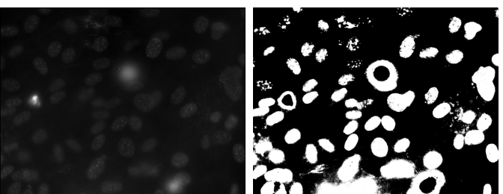
NIH3T3: Two-level Otsu thresholding clip
Original image
Segmentation

Slide 19
Local adaptive Otsu thresholding

Slide 20
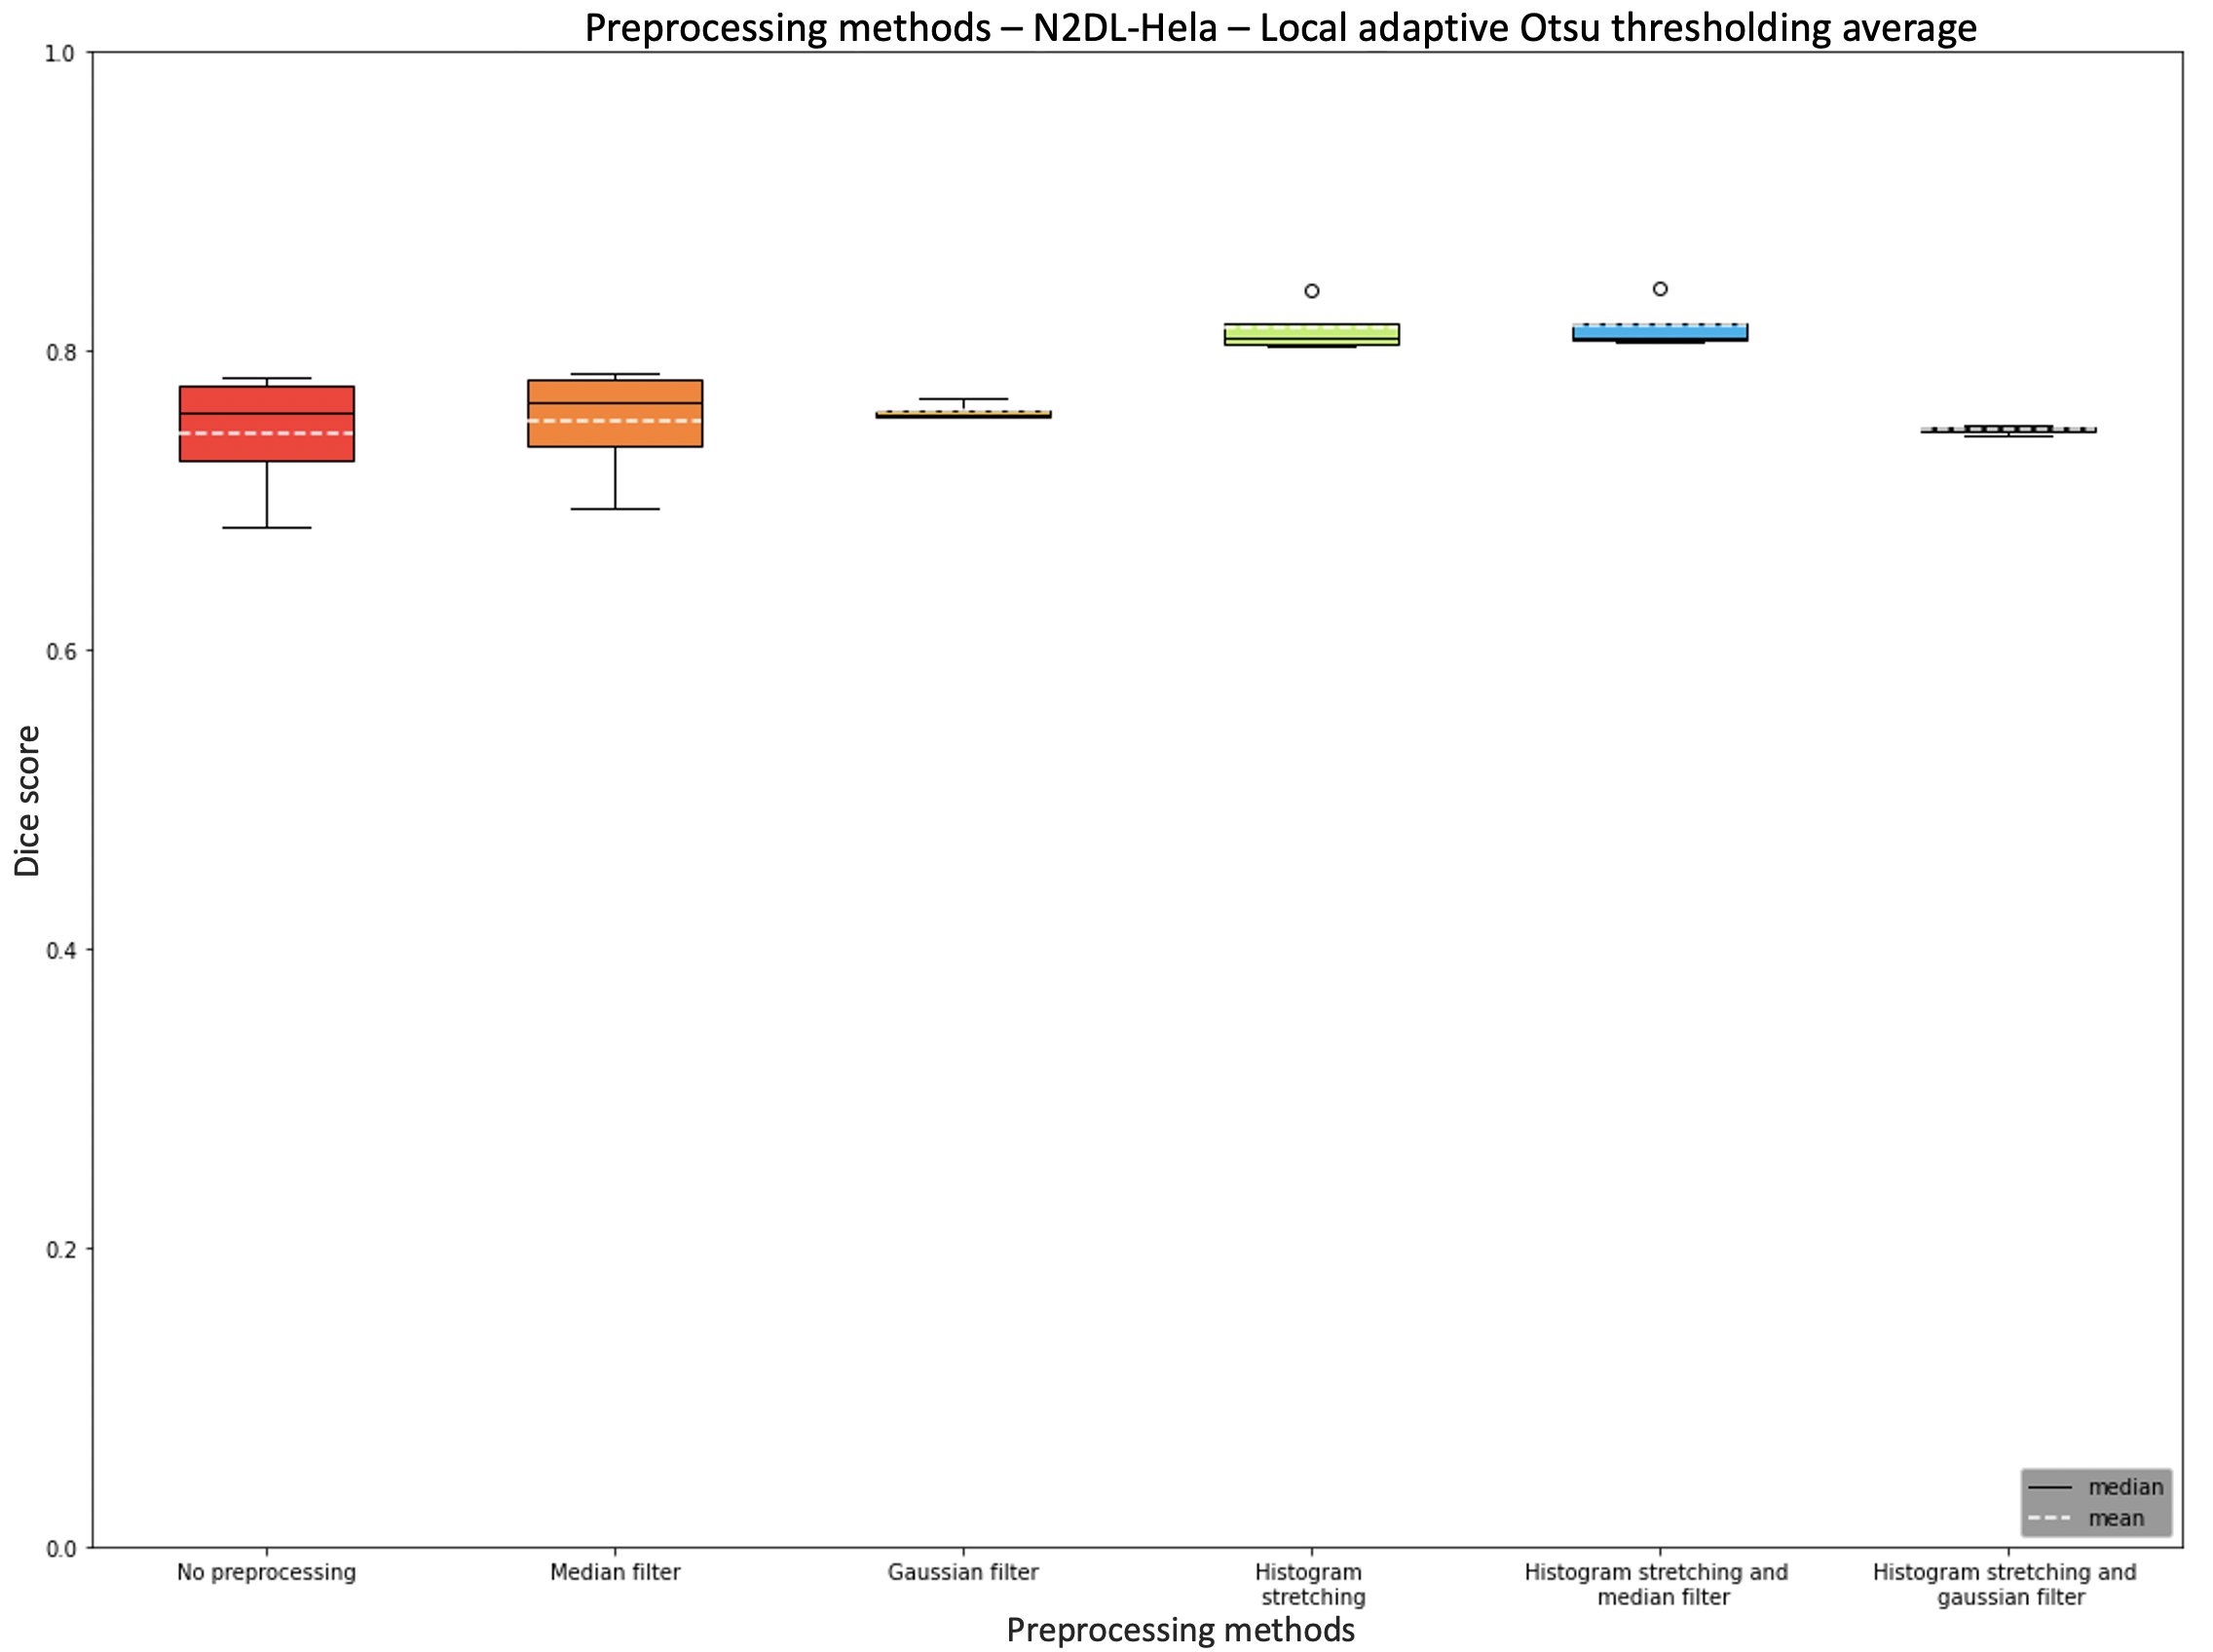
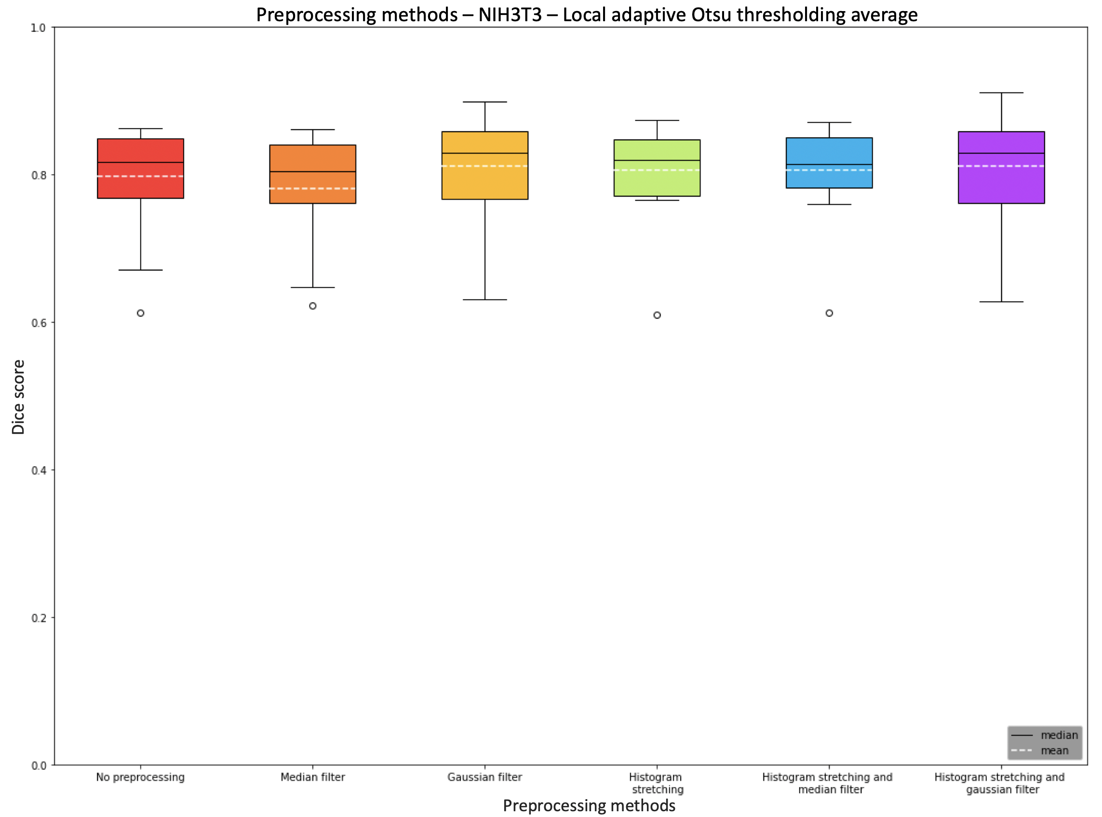
Preprocessing methods N2DL-HeLa and NIH3T3
No Preprocessing
Median filter
Gaussian filter
Histogram stretching
Histogram stretching and median filter
Histogram stretching and Gaussian filter

Slide 21
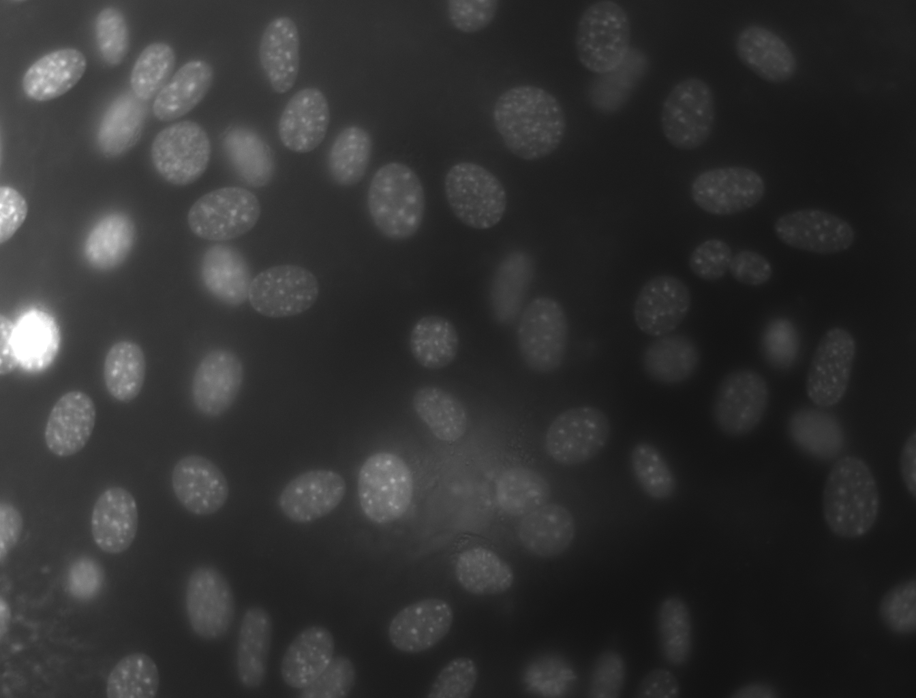
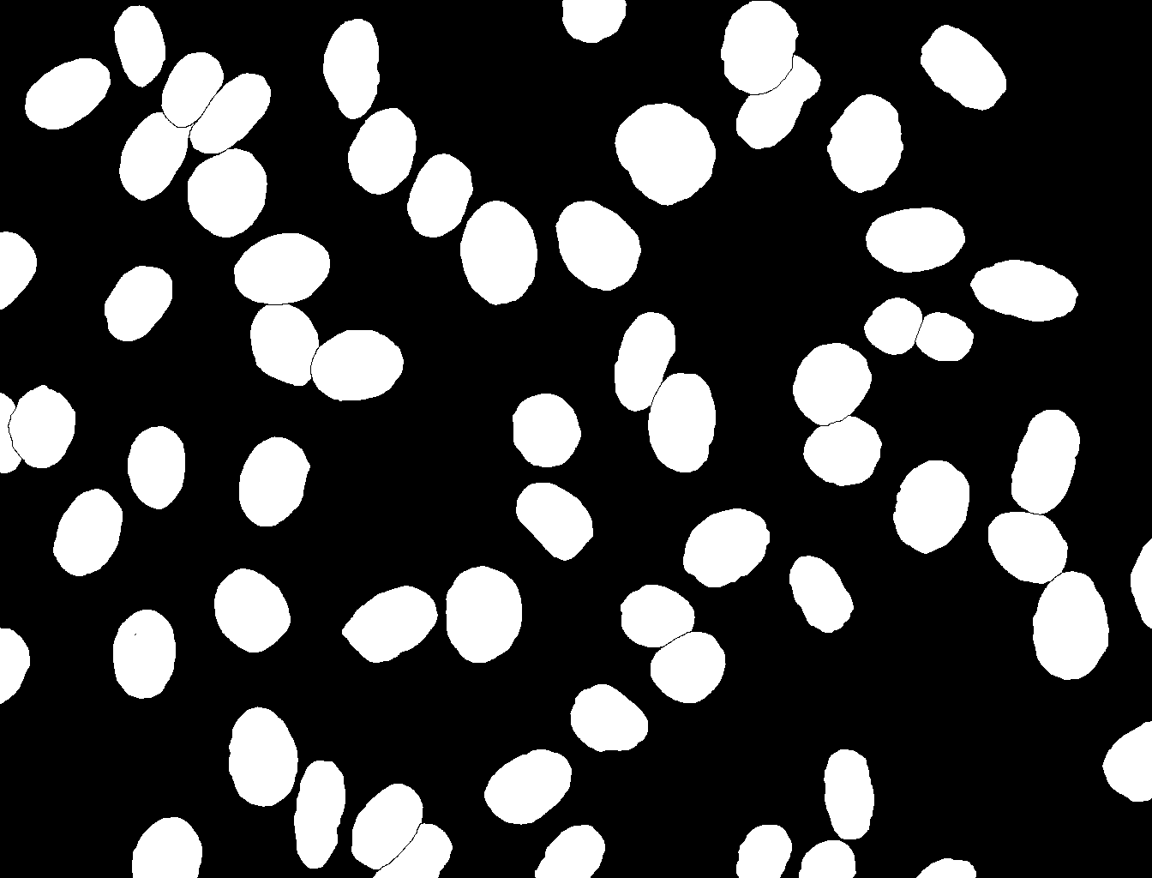
NIH3T3: Effects of local adaptive Otsu thresholding
Original image
Ground truth

Slide 22
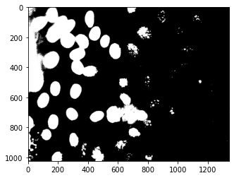
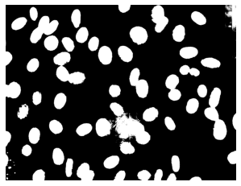
NIH3T3: Effects of local adaptive Otsu thresholding
Segmentation (global)
Segmentation (local)
Ground truth

Slide 23
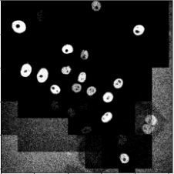
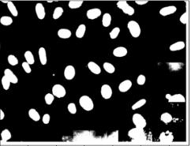
Challenges
Background noise
Unsegmented edges

Slide 24
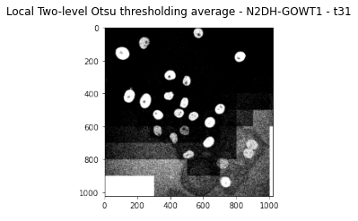
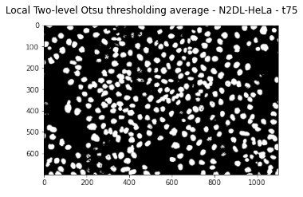
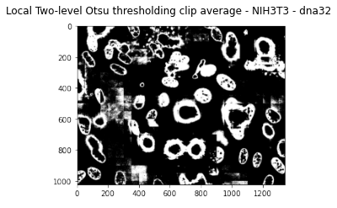
Local adaptive two-level Otsu thresholding

Slide 25
Challenges

Slide 26
Challenges
Runtime
Optimal bin size
Optimal filter size
Edge issue
Local adaptive Otsu thresholding count vs. average

Slide 27
Optimal segmentation method

Slide 28
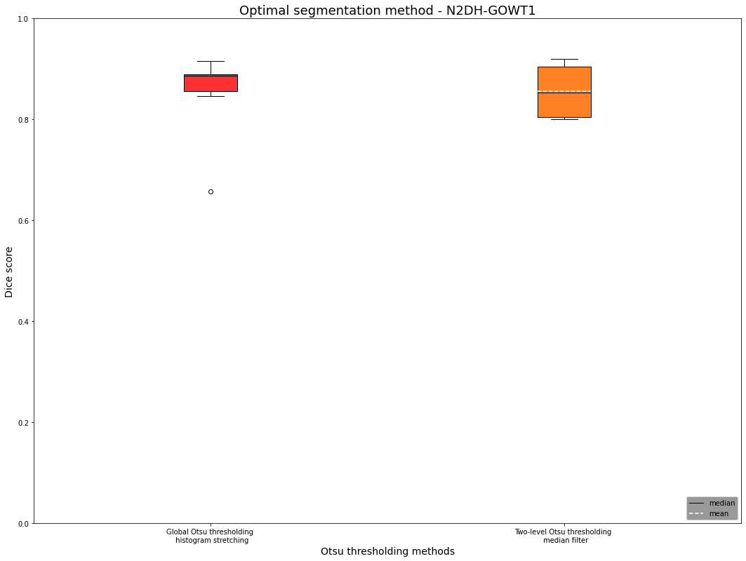
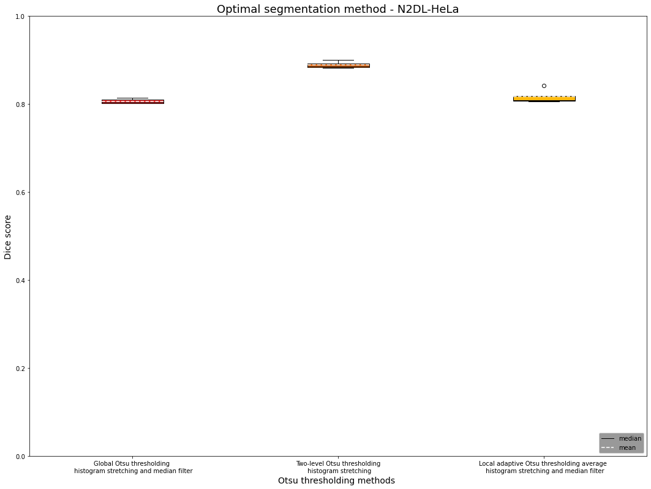
Optimal segmentation method for N2DH-GOWT1 and N2DL-HeLa
Global Otsu thresholding Histogram stretching
Two-level Otsu thresholding median filter
Global Otsu thresholding Histogram stretching and median filter
Two-level Otsu thresholding Histogram stretching
Local adaptive Otsu thresholding average
Histogram stretching and median filter

Slide 29
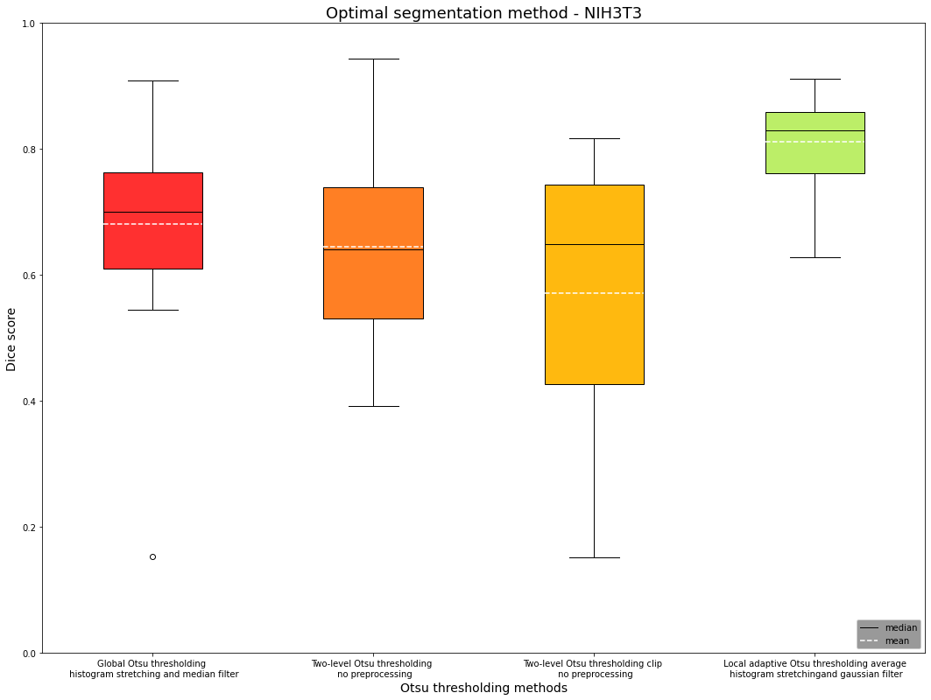
Optimal segmentation method NIH3T3
Global Otsu thresholding
Histogram stretching and median filter
Two-level Otsu thresholding
No preprocessing
Two-level Otsu
thresholding clip
No preprocessing
Local adaptive Otsu thresholding average histogram stretching and Gaussian filter

Slide 30

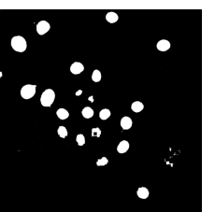
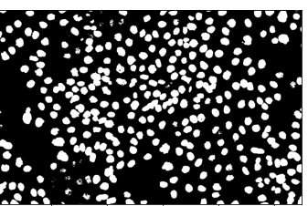
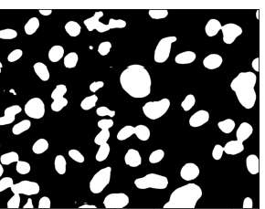
N2DL-HeLa (second dataset)
The perfect recipe
N2DH-GOWT1 (first dataset)
NIH3T3
(third dataset)
Preprocessing: histogram stretching
Postprocessing: hole filling
Otsu: global Otsu thresholding
Final median Dice Score: 0.8864
Preprocessing: histogram stretching
Otsu: two-level Otsu thresholding
Final median Dice Score: 0.8866
Preprocessing: Gaussian filter + histogram stretching
Otsu: local adaptive Otsu thresholding
Final median Dice Score: 0.8293
L: low resolution
N: nuclear
H: high resolution
2D: two-dimensional

Slide 31
Conclusion

Slide 32
 |  | Global Otsu Thresholding | Two-level Otsu thresholding | Two-level Otsu Clip | Local adaptive thresholding average
N2DH-GOWT1 | Preprocessing method | Histogram stretching | Median filter
 | Dice Score | 0.89 | 0.85
N2DL-HeLa | Preprocessing method | Histogram stretching and median | Histogram stretching |  | Median filter and histogram stretching
 | Dice Score | 0.80 | 0.89 |  | 0.81
NIH3T3 | Preprocessing method | Histogram stretching and median | No preprocessing | No preprocessing | Gaussian filter and histogram stretching
 | Dice Score | 0.70 | 0.64 | 0.65 | 0.83

Slide 33
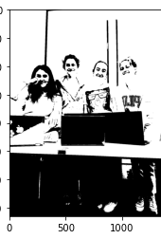
Thank you for your attention!

Slide 34

Extra slides

Slide 35
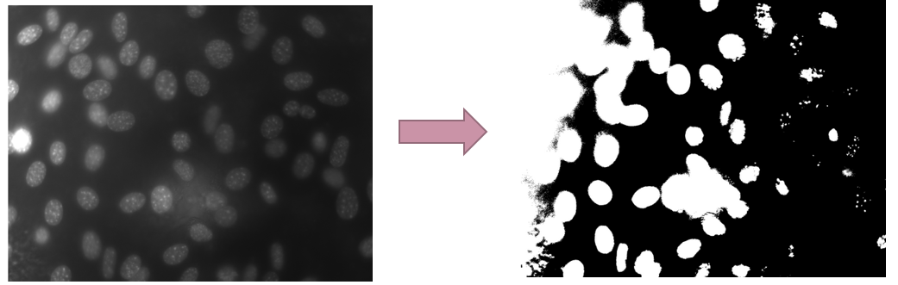
Why local thresholding?

Slide 36
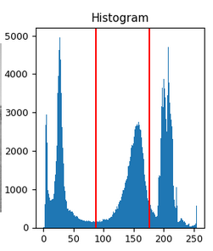
Why two-level thresholding
Cell nuclei with brighter intensity values y
Cell nuclei with intensity values x
https://scikit-image.org/docs/stable/auto_examples/segmentation/plot_multiotsu.html

Slide 37
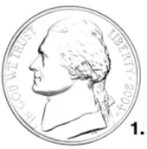
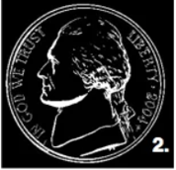
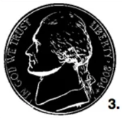
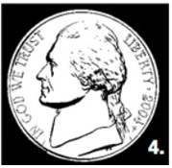
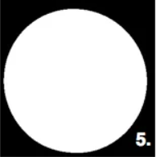
Hole filling
https://learnopencv.com/filling-holes-in-an-image-using-opencv-python-c/

Slide 38
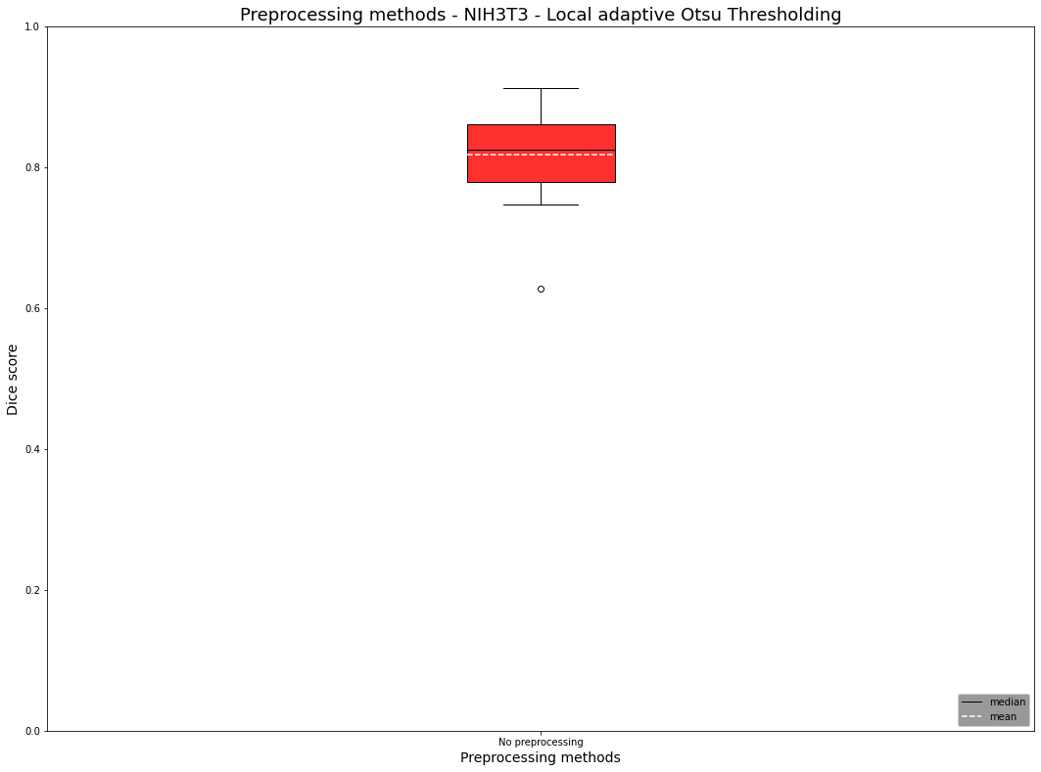
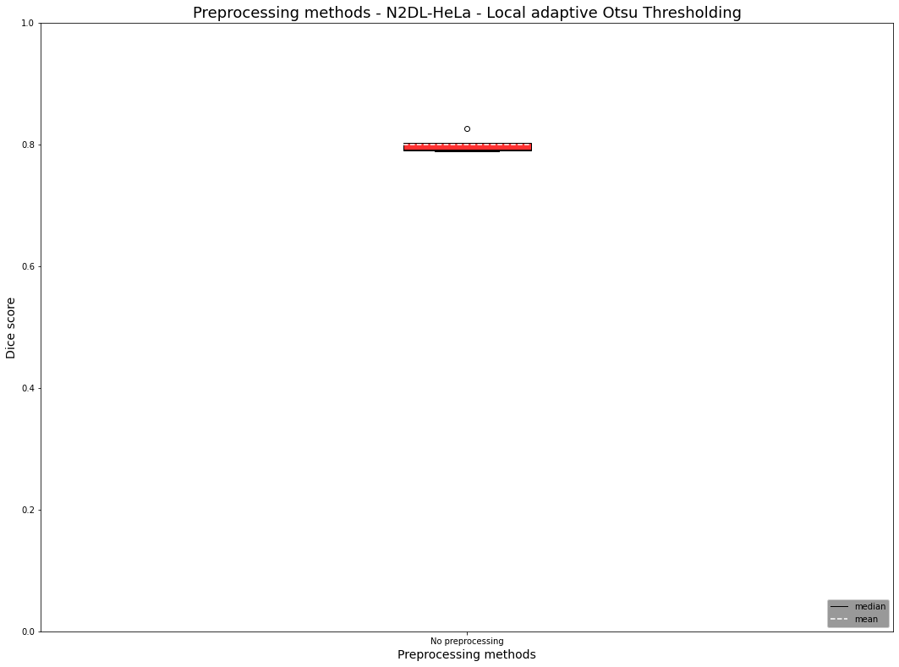
Correction Local

Slide 39
Solution Ideas
Challenge | Solution
Random noise | Gaussian filter, median filter
Holes | Median filter
Low contrast | Histogram stretching
Reflections | Intensity clipping, multithresholding
Brightness | Local thresholding

Slide 40
Challenges: N2DL-HeLa
Reflections

Slide 41
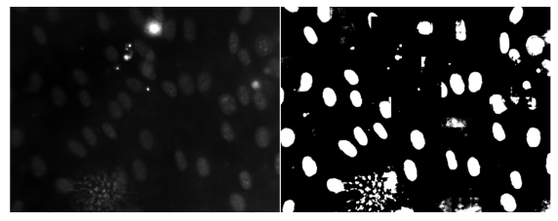
NIH3T3: Effects of local adaptive Otsu thresholding

Slide 42
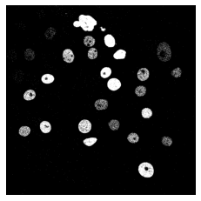
Histogramm stretching
Segmentation without histogram stretching

Slide 43
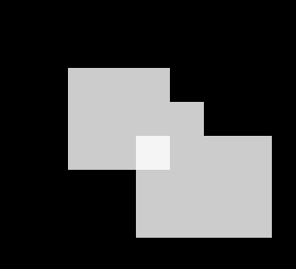


Dice score - Issues

Slide 44
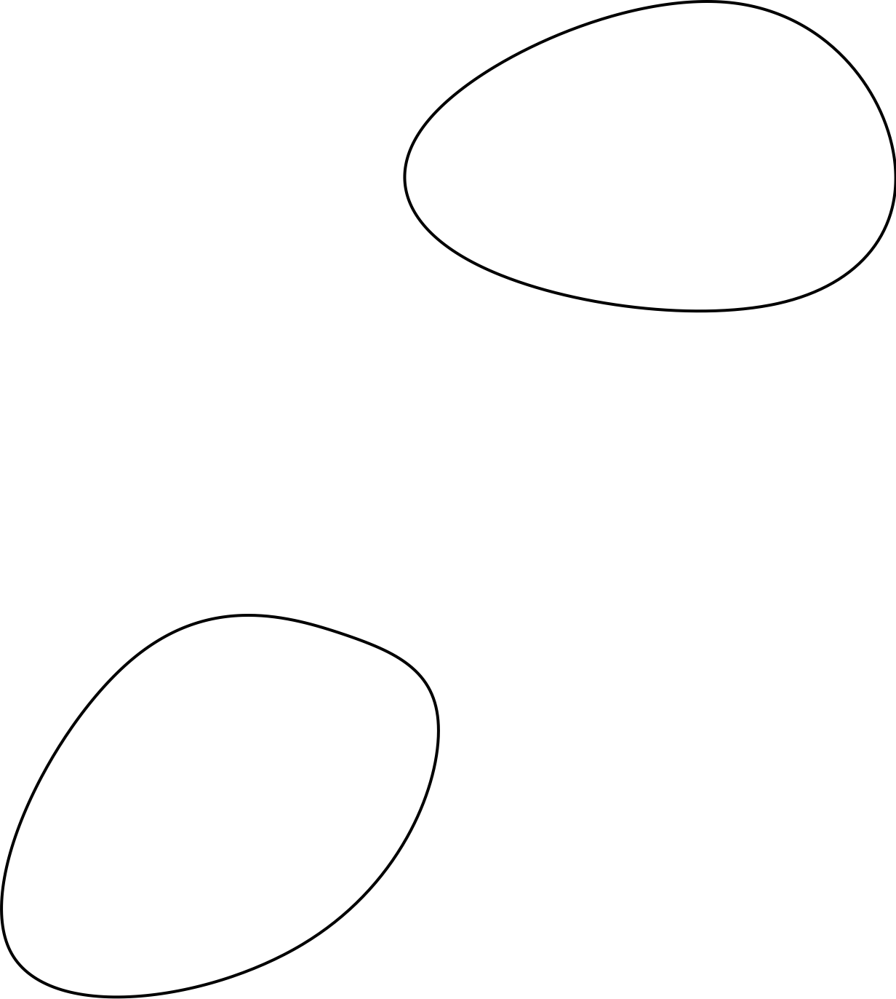
Evaluation algorithm – Dice score
~ 80% Accuracy

Slide 45

N2DH-GOWT1 Cell type: embryonic stem cells | Organism: Mouse (Mus musculus)
Express Oct4-GFP
Leica TGS SP5 (confocal microscope)
6 images total
1024x1024 pixels
10-20 nulei per image

Slide 46
NIH3T3 Cell type: Embryonic fibroblast cells | Organism: Mouse (Mus musculus)
Stained with Hoechst (fluorescent dye)
Fluorescence microscope
18 images total
Size: 1344x1024 pixels
about 60 nuclei per image

Slide 47

N2DL-HeLa Cell type: cervical adenocarcinoma cells | organism: human (Homo sapiens)
Express H2B-GFP
Olympus IX81 Confocal Microscope
4 images total
Size: 1100x 700 pixels
30-50 nuclei per image

Slide 48
Otus Thresholding usage
Locate cell boundaries
Cell type classification
Cell counting
Cell phenotype analysis (size, shape,..)
But not used for very complex images !

Slide 49





Otsu Thresholding
Class probabilities ($ω_{0,1}$):
Class mean levels ($μ_{0,1}$) and total mean level ($μ_{T}$):
Class variances ($σ_{0,1}^{2}$) and total variance ($σ_{T}^{2}$):
$L=$ Number of gray levels in the picture
$n_{i}=$ Number of pixels at level i
$N=$ Total number of pixels
$p_{i}=$ Probability of level i
$k=$ Threshold intensity
$$p_{i}= n_{i}/N$$
Otsu, N. "A threshold selection method from gray-level histograms." IEEE Transactions on Systems, Man, and Cybernetics 9:1 (1979), pp 62-66.

Slide 50





Otsu Thresholding
http://www.labbookpages.co.uk/software/imgProc/otsuThreshold.html

Slide 51



Discriminant Criterion Measure
Criterion measure
$η\left(T\right)=σ_{B}^{2}\left(T\right)/$ $σ_{T}^{2}$
$σ_{B}^{2}$= Between-class variance
$σ_{T}^{2}$ = Total variance
$0≤η^{∗}≤1$
Otsu, N. "A threshold selection method from gray-level histograms." IEEE Transactions on Systems, Man, and Cybernetics 9:1 (1979), pp 62-66.

Slide 52

Holes

Slide 53

Histogram stretching
stretching range of intensity values to achieve a higher contrast -> linear scaling
Pout = (Pin – c )($\frac{b−a}{d−c}$ ) + a
https://homepages.inf.ed.ac.uk/rbf/HIPR2/stretch.htm

Slide 54

Example Histogram stretching
https://i.stack.imgur.com/9gIw6.png

Slide 55


Two-level Otsu Thresholding
Two-level Otsu Thresholding
$σ_{B}^{2}=ω_{1}\left(μ_{1}−μ_{T}\right)2−$ $ω_{2}\left(μ_{2}−μ_{T}\right)2−$ $ω_{3}\left(μ_{3}−μ_{T}\right)2$
$ω_{1,2,3}$ = Probabilities of class occurrence
$μ_{1,2,3}$ = Class mean levels
$μ_{T}$ = Total mean level
Otsu, N. "A threshold selection method from gray-level histograms." IEEE Transactions on Systems, Man, and Cybernetics 9:1 (1979), pp 62-66.

Slide 56
Application of Filter
Choose Filtermask
Convolution
Flipping filter
Multiplication of filter values with image intensity values
Summation of the multiplication results

Slide 57



Procedure
Input image
Preprocessing
global Otsu thresholding
Dice Score
Two-level Otsu thresholding
Local adaptive Otsu thresholding
Postprocessing

